Slide 2
Desertification and Land Degradation - What does it mean?
Desertification: Degradation of land in arid, semi-arid, and dry sub-humid areas (Not the natural expansion of existing deserts)
Land Degradation: Deterioration in the quality of land (its topsoil caused usually by excessive or inappropriate exploitation)
Causes: Overexploitation, overgrazing, deforestation, and poor irrigation practices
Solutions: Prevention of Soil Erosion, Water Resource Management, Sustainable Practices
Extent of Land undergoing Degradation
World – 40000 Lakh hectares (1/3 ^{rd} of total geographic area)
India - 960 Lakh Hectares (29.32 % of total geographic area)

Slide 3
About UNCCD
United Nations Convention to Combat Desertification (UNCCD) – Bonn (Germany)
Legally binding international agreement linking environment and development to sustainable land management;
One of the 3 Rio Conventions to evolve from the historic ‘Earth Summit’ held at Rio De Janerio, Brazil, in 1992. Adopted in Paris in June 1994
UNFCCC
CBD
UNCCD
India became a signatory in 1994 and ratified in 1996.

Slide 4
Conference of Parties (COP) – What is it?
Established by the Convention –
The Supreme decision-making body ;
197 country parties (including EU) as constituent members.
Main Functions -
Review reports submitted by the Parties & make recommendations, adopt new annexes
to the Convention
Guides the Convention as global circumstances and national needs change.
COP meetings held biennially since 2001. COP-13: Held in Ordos, China in Sept 2017.
COP-14 (2-13 September): India will take over COP Presidency from China for
the next two years (2019-2021).

Slide 5
DELEGATE PARTICIPATION FOR UNCCD COP -14
Total No. of Countries Participating | 196 (+ EU)
Total No. of International Delegates expected | 3000+
Total No. of Environment Ministers expected | 94
Total No. of National Participants Nominated | 600
Plenary Hall - Hall 4
Main Committee Room – Hall 2
21 Meeting Rooms - Hall 1 to 8
40 Exhibition Booth – Hall
04 Side Events Rooms – Hall 1 to 8

Slide 6
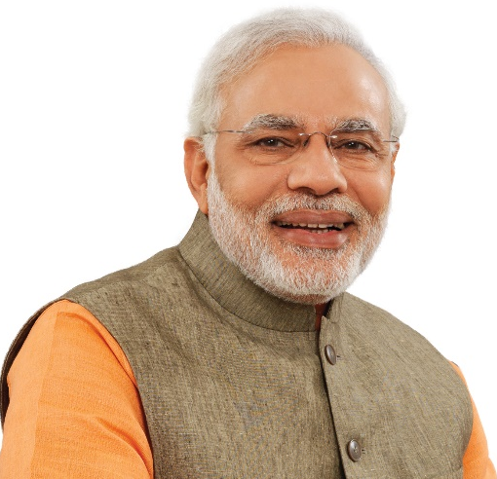
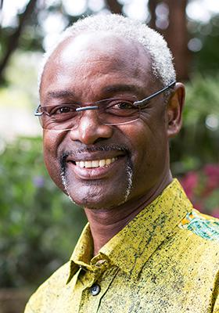
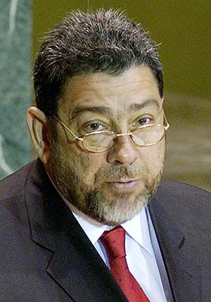
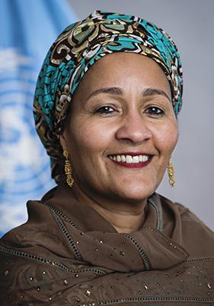
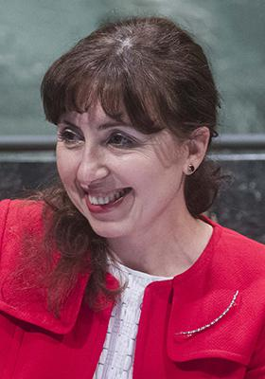
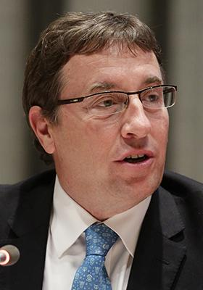
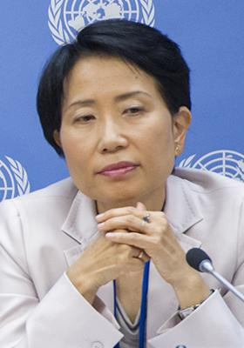
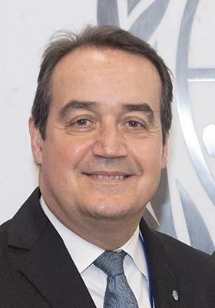
IMPORTANT DIGNITARIES ATTENDING UNCCD COP -14
Ibrahim Thiaw
ES UNCCD
Ralph E Gonsalves
PM of St Vincent & The Grenadines
Narendra Modi
PM of India
Amina Mohammed
UN Dy SG
Christiana Pasca
ED CBD
Plenary Hall - Hall 4
Main Committee Room – Hall 2
21 Meeting Rooms - Hall 1 to 8
40 Exhibition Booth – Hall
04 Side Events Rooms – Hall 1 to 8
Naoko Ishii
GEF CEO/Chairperson
Achim Steiner
UNDP Administrator
Yanneck Glemarec
ED GCF

Slide 7
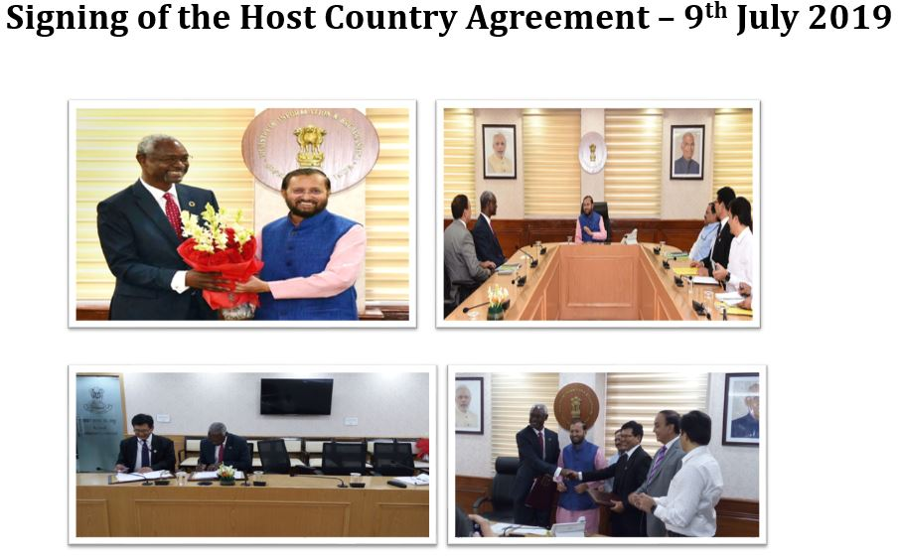
UNCCD Secretariat-Role
Formal organisation of COP 14 Sessions
Documentation, Conference Services
Interpretation in UN Languages
Procedural running of COP & subsidiary bodies
India-Role
Leadership
Operational Part of COP
Provision of Entire Logistical Arrangements
Support to Negotiation Process

Slide 8
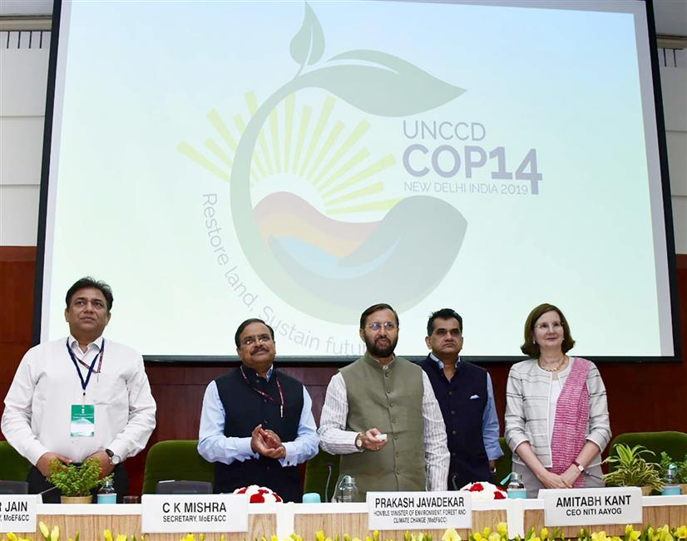
17th June, 2019: Launch of COP 14 Logo at ‘World Day to Combat Desertification’
LOGO given by India – what does it signify?
A successful use of Government’s IT outreach through crowd sourcing.
Sapling rising from bottom to top shows progress while the leaves on the top represent life itself, while Sun’s rays depict hope.
Land and water in the logo shows importance as being the source of life.
The hand represents the importance of human involvement for the betterment of life.

Slide 9
Agenda Highlights: CoP-14 meetings
COP dates: 2 - 13 September 2019 (Regional Meeting starting 31 Aug-01 Sept 2019)
Mon 2/9
Opening of the COP
Mon 2/9-
Fri 6/9
Mon 9/9-
Tue 10/9
Committee Of the Whole, Working Groups, Open Dialogue Sessions
Wed 11/9-
Fri 13/9
Open Dialogue Sessions, Committee of the Whole, Closing of the COP
Election of the President and Vice-President, Adoption of the Agenda, Accreditations
Presentation of reports submitted by the parties, discussion on decisions and resolutions
Presentation of reports by parties, discussion on decisions and resolutions
High Level Segments
Roundtable and dialogue sessions on value chains, health & faith communities, New Delhi Initiative.
Notes:
The COP was established by the Convention as the supreme decision-making body; it comprises ratifying governments and regional economic integration organizations, such as the European Union. Up to today, the COP had held twelve sessions; it has been meeting biennially since 2001.This year, COP13 will be held in Ordos, China.
The core budget is approved by the COP each biennium, which includes an approval of a two-year work programme indicating core and extra-budgetary requirements.
The core budget for the UNCCD operation by the secretariat is based on the mandatory commitment (core budget) by Parties, but the interest and level of voluntary contributions are up to each Party.
(Refer to the slide 25)
Core budget for the biennium 2016-2017
EUR 16.2 million
Voluntary contributions
EUR 10 million

Slide 10
Agenda highlights- Exhibition and side events
30/8
31/8
1/9
2/9
3/9- 6/9
Volunteer training
CRIC bureau, CST bureau
Youth Forum, Training Fair
COP bureau
CSO preparatory meeting, Media training
Global Land Outlook steering committee
Committee on Science and Technology (CST)
7/9- 12/9
Technology Fair
3/9-12/9
Rio Convention Pavilion, Science Day, Sand and Dust Storms Day, Migration Day, Women’s Caucus, Drought Day…
31/8 & 2/9
Science-Policy Interface
3/9- 5/9 & 11/9- 12/9
Committee for the Review of the Implementation of the Convention (CRIC)
Notes:
The COP was established by the Convention as the supreme decision-making body; it comprises ratifying governments and regional economic integration organizations, such as the European Union. Up to today, the COP had held twelve sessions; it has been meeting biennially since 2001.This year, COP13 will be held in Ordos, China.
The core budget is approved by the COP each biennium, which includes an approval of a two-year work programme indicating core and extra-budgetary requirements.
The core budget for the UNCCD operation by the secretariat is based on the mandatory commitment (core budget) by Parties, but the interest and level of voluntary contributions are up to each Party.
(Refer to the slide 25)
Core budget for the biennium 2016-2017
EUR 16.2 million
Voluntary contributions
EUR 10 million

Slide 11
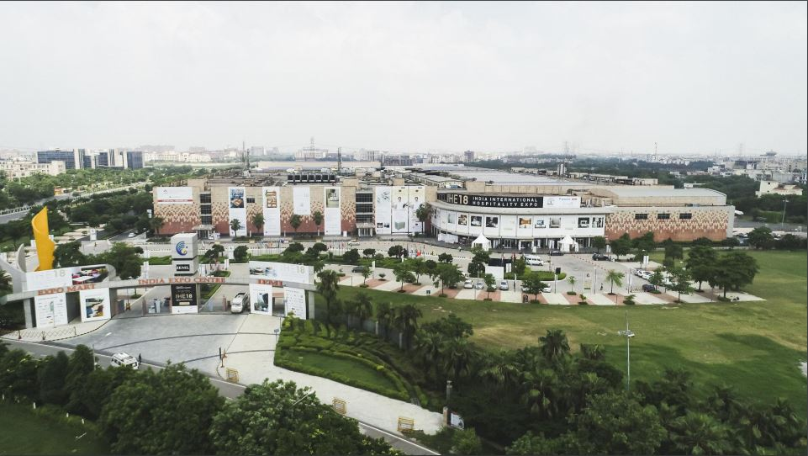
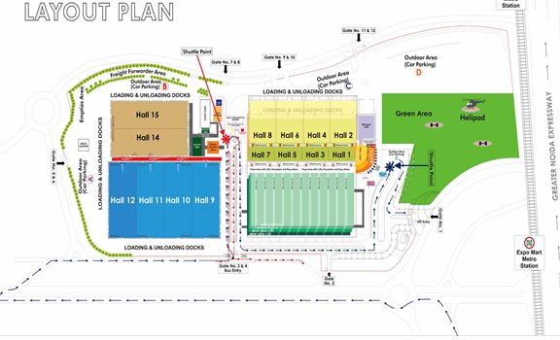
Venue: India Exposition Centre and Mart, Knowledge Park II, Greater Noida
25 Mins from Delhi
60 Mins from Airport

Slide 12
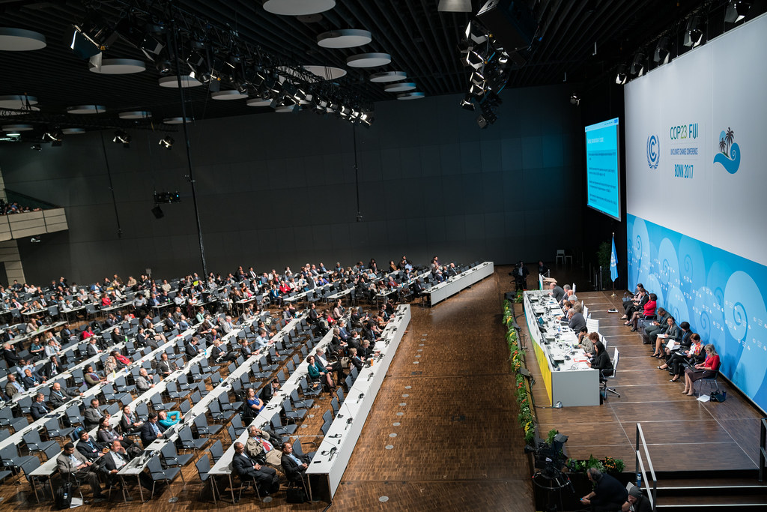
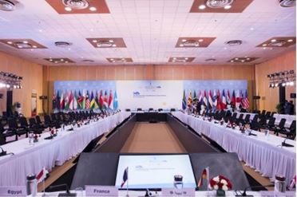
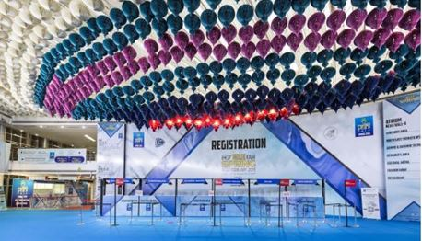
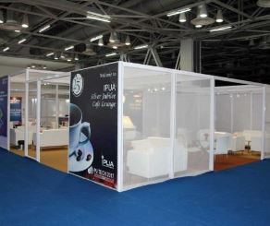
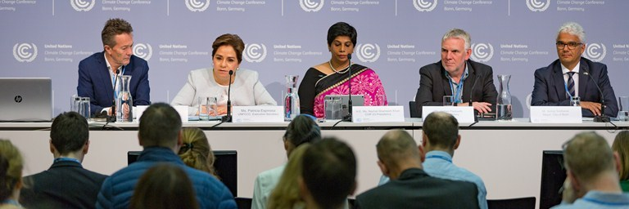
Venue: COP 14 - Meeting Room Provisions and Logistics
Meeting Rooms
Plenary Hall
Registration Desks
Plenary Hall - Hall 4
Main Committee Room – Hall 2
21 Meeting Rooms - Hall 1 to 8
40 Exhibition Booth – Hall
04 Side Events Rooms – Hall 1 to 8
Exhibition Booths
Press Conference Room

Slide 13
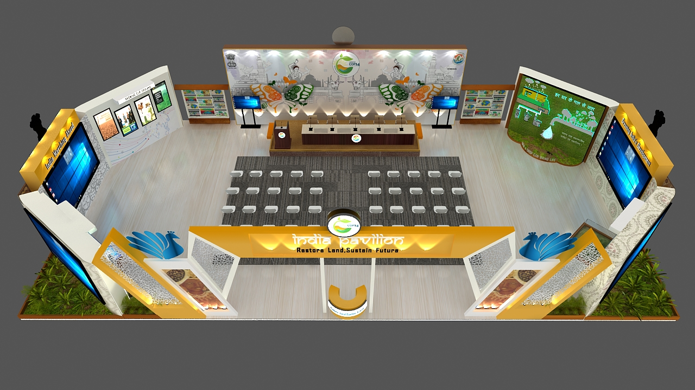
Highlight of COP-14: INDIA PAVILION (Hall 5, GROUND FLOOR)
Main Highlights
200 Sqr Mtr Space to showcase India’s effort to tackle DLDD issues.
Participation of more than 10 Line Ministries, States, Civil Society members
Representations from Premier Scientific Organisations like ISRO, ICFRE, ICAR
Special Sessions on role of technology
Eminent speakers from Government, Academia, Scientific Institutions, Civil Society
Schedule to be available on https://unccdcop14india.gov.in
Plenary Hall - Hall 4
Main Committee Room – Hall 2
21 Meeting Rooms - Hall 1 to 8
40 Exhibition Booth – Hall
04 Side Events Rooms – Hall 1 to 8

Slide 14
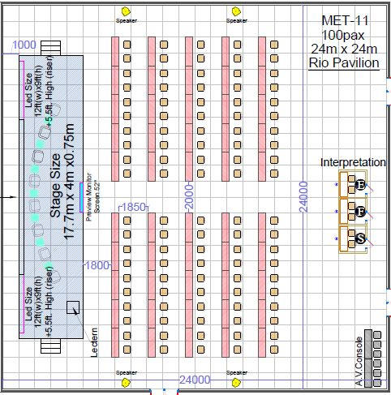
Highlight of COP-14: RIO CONVENTION PAVILION (Hall 5, Ground Floor)
Date | Programme Overview
3 Sep | Day of Synergies
4 Sep | Morning to think about Green Environment Afternoon to caucus on Gender
5 Sep | Day of science The GEF evening
6 Sep | Day of Sand and Dust storms
9 Sep | The GEF Day
10 Sep | Day of action for Land
11 Sep | Day of Drought
12 Sep | Day of Land Degradation neutrality
Plenary Hall - Hall 4
Main Committee Room – Hall 2
21 Meeting Rooms - Hall 1 to 8
40 Exhibition Booth – Hall
04 Side Events Rooms – Hall 1 to 8

Slide 15
India - Major Announcements for COP 14
 | Initiatives for India | Announcements
1 | LDN Targets for India | Restoration of 50 Lakh Hectares of Degraded Land.
2 | New Delhi Declaration | COP-14 Country Party Decisions
3 | Centre for Excellence for LDN-TSP | South-South Cooperation: Premier Global Technical Support Institute to train UNCCD Country Parties
5 | UNCCD Drought Initiative | India to join UNCCD initiative
Plenary Hall - Hall 4
Main Committee Room – Hall 2
21 Meeting Rooms - Hall 1 to 8
40 Exhibition Booth – Hall
04 Side Events Rooms – Hall 1 to 8

Slide 16
Land Degradation Neutrality (LDN) Targets at National Level
India is committed to achieve LDN Targets by 2030
Main interventions focuses on restoring land productivity and ecosystem services of 50 Lakh hectares by adopting a landscape restoration approach.
Aim for no net loss in terms of land degradation for the whole territory of India.
Key National Focus Areas
Restoring Productivity of different land cover and land-use classes
Ensuring Livelihood security and Improving Farm incomes
Conserve Biodiversity and ecosystem services
Sustainable Management of water sources
Resilience to Climate change
To Improve soil organic carbon stocks.
Geographical Focus Areas
Drylands, Rain-fed areas, Desert
Rehabilitation of vulnerable ecosystem of Himalayas, Aravalis, Western Ghats and Deccan plateau
Degraded forests, Scrub and open forest areas
Eroded-Coastal areas, Salinity affected areas and Mangroves; wetlands and water bodies
Recharge of sub-surface aquifers
Plenary Hall - Hall 4
Main Committee Room – Hall 2
21 Meeting Rooms - Hall 1 to 8
40 Exhibition Booth – Hall
04 Side Events Rooms – Hall 1 to 8

Slide 17
South South Centre for Sustainable Land Restoration
Centre of Excellence for Capacity Building of Developing Countries at ICFRE, Dehradun (an autonomous Institute under the MoEFCC)
A move to assist developing countries in their efforts to achieve LDN and raise income of poor people. Global technical support institute for UNCCD country parties for their capacity building and support regarding the Land Degradation Neutrality Target Setting Programme.
India can impart training to the country parties for the following components:
LDN Assessment – (Baseline Mapping)
Leveraging LDN – (Mapping Existing Schemes and Programmes)
LDN Target Setting - (Setting Priorities and Targets)
Achieving LDN – (Transformative Project)
Financing Solutions
Plenary Hall - Hall 4
Main Committee Room – Hall 2
21 Meeting Rooms - Hall 1 to 8
40 Exhibition Booth – Hall
04 Side Events Rooms – Hall 1 to 8

Slide 18
Facebook.com/
UNCCDCOP14INDIA
@India4Land/
UNCCDCOP14INDIA
Likes: 2000+
Impressions:
Reach:
Following:
Impressions:
Reach:
https://unccdcop14india.gov.in
Thank You!

